Slide 1

Advocadabra Developed By
3rd year (5th Sem) – PS Project
An AI-driven Legal Decision Support System using LLMs and Machine Learning.
245523748119
SHINDE ABHINAV
245523748096
Kesapragada Pavana
Srinandana Sarma
245523748111
P.SriKruthin
245523748087
JYE PRAHAAS PENTLAVELLI
245523748122
Udit Kandi

Slide 2
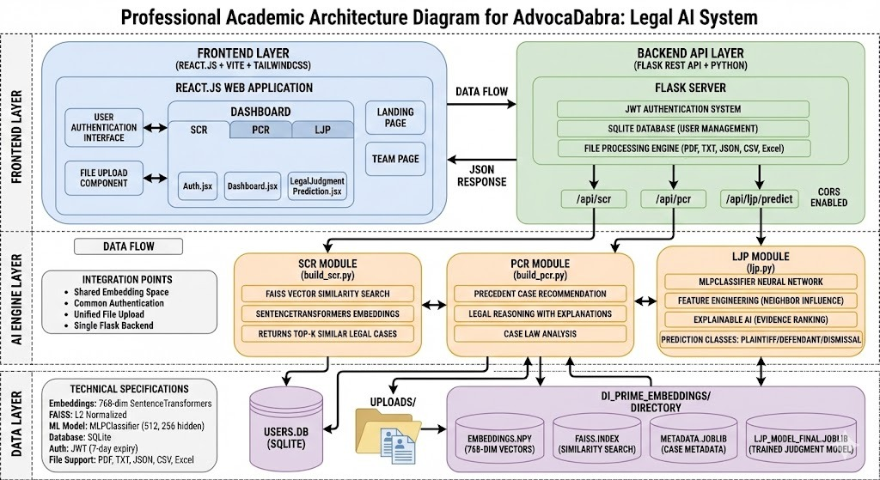
Solution Architecture

Slide 3
Architecture explanation Layer 1: The Frontend Layer (User Interface)
Purpose: This layer is the entry point for the user. It handles all interactions, visualizes data, and securely manages user sessions.
Technology Stack: Built using React.js for the framework, Vite for fast building/tooling, and Tailwind CSS for styling.
Key Components:
Dashboard: The central hub housing the three core legal tools: SCR (Similar Case Retrieval), PCR (Precedent Case Recommendation), and LJP (Legal Judgment Prediction).
User Authentication Interface: Manages secure login and registration.
File Upload Component: Allows users to upload legal documents (PDF, TXT, JSON, etc.) which are then sent to the backend for analysis.
Routing (Auth.jsx, Dashboard.jsx, etc.): Modular React components that dynamically render the correct view based on user selection.

Slide 4
Layer 2: The Backend API Layer (Orchestrator)
Purpose: This layer acts as the bridge between the user interface and the complex AI engines. It processes requests, manages security, and routes data.
Technology Stack: Flask (Python) serving as a REST API.
Key Components:
Flask Server: The main application server that listens for requests from the frontend.
JWT Authentication System: Uses JSON Web Tokens to ensure that only authorized users can access the API. Tokens generally have a 7-day expiry (as noted in specifications).
File Processing Engine: A specialized utility that parses uploaded files (PDFs, CSVs, etc.) into raw text that the AI models can understand.

Slide 5
API Endpoints:
/api/scr: Route for Similar Case Retrieval.
/api/pcr: Route for Precedent Case Recommendations.
/api/ljp/predict: Route for Legal Judgment Predictions.
CORS Enabled: Cross-Origin Resource Sharing is configured to allow the React frontend to communicate safely with the Flask backend.

Slide 6
Layer 3: The AI Engine Layer (The "Brain")
Purpose: This is the core intelligence layer where machine learning models process data to provide legal insights. It is divided into three distinct modules.
1. SCR Module (Similar Case Retrieval)
Function: Finds past legal cases that are semantically similar to the user's query.
Tech: Uses SentenceTransformers to convert text into mathematical vectors (embeddings) and FAISS (Facebook AI Similarity Search) for ultra-fast vector similarity search.
Output: Returns the "Top-K" (e.g., top 5 or 10) most similar legal cases.

Slide 7
2. PCR Module (Precedent Case Recommendation)
Function: Goes beyond simple similarity to recommend cases that serve as strong legal precedents.
Tech: Focuses on legal reasoning and case law analysis.
Output: Provides specific case recommendations accompanied by explanations of why they are relevant to the current scenario.
3. LJP Module (Legal Judgment Prediction)
Function: Predicts the likely outcome of a case.
Tech: Uses an MLPClassifier (Multi-Layer Perceptron), a type of Neural Network.
Architecture: 512 input nodes, 256 hidden nodes.
Feature Engineering: Uses "Neighbor Influence" (analyzing how similar past cases were decided) to inform its prediction.
Output: A classification of Plaintiff (Win), Defendant (Win), or Dismissal.

Slide 8
Layer 4: The Data Layer (Storage & Persistence)
Purpose: Stores the static models, dynamic user data, and the high-dimensional vector data required for the AI to function.
Relational Database:
USERS.DB (SQLite): Stores user credentials and profile information.
File Storage:
UPLOADS/ Directory: Temporarily stores documents uploaded by users for processing.
AI Model Storage (DL_PRIME_EMBEDDINGS/):
EMBEDDINGS.NPY: A NumPy file containing the 768-dimensional vector representations of legal texts.
FAISS.INDEX: The search index that allows the SCR module to find similar vectors instantly.
METADATA.JOBLIB: specific metadata about cases (dates, courts, judges).
LJP_MODEL_FINAL.JOBLIB: The trained Neural Network model used for making judgment predictions.

Slide 9
Architectural changes
Feature | Architecture 1 (Conceptual) | Architecture 2 (AdvocaDabra Final)
Core AI Models | Gemma-7B, Mistral-7B | SentenceTransformers, MLPClassifier
LJP Approach | Generative (Text Generation) | Classification (Plaintiff / Defendant / Dismissal)
Vector Store | ChromaDB | FAISS (L2 Normalized)
Backend | Implied / Generic | Flask REST API
Primary Goal | Reasoning & Generation | Retrieval & Classification

Slide 10
Technology Stack & Tools
Programming Language: Python 3.9+
AI & Machine Learning Libraries:
PyTorch / SentenceTransformers: For generating 768-dimensional embeddings (Model: intfloat/e5-base).
FAISS (Facebook AI Similarity Search): For high-speed vector indexing and retrieval.
Scikit-Learn: For the Multi-Layer Perceptron (MLP) classifier and data preprocessing.
NumPy & Pandas: For matrix operations and data manipulation.
Web Frameworks (Full Stack):
Backend: Flask (Python REST API).
Frontend: React.js + Vite + TailwindCSS.
Databases & Storage:
Vector DB: FAISS Index (.index file).
Metadata: Joblib (metadata.joblib) & JSONL.
User Data: SQLite.
Development Tools: VS Code, Git/GitHub.

Slide 11
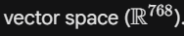
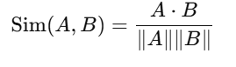
Mathematical Foundation
Mathematical formulas are :
1.Similarity (Cosine)
2. Ranking Formula
3. Loss Function
4. Network Topology
1. SCR Module(Similarity Search):
Algorithm: K-Nearest Neighbors (KNN) with Cosine Similarity. Explanation: We project legal documents into a high-dimensional Retrieval is performed by finding the nearest vectors on the hypersphere.
Formula for Slide:

Slide 12
2. PCR Module: Precedent Ranking Algorithm
Algorithm: Linear Weighted Utility Function. Explanation: Raw similarity is insufficient for legal precedence. We re-rank candidates using a utility function that rewards court authority and reasoning depth while penalizing procedural dismissals.
Formula for Slide:
Parameters (from your code):
w1 = 1.0(Semantic Similarity weight)
w2 = 0.20 (Court Authority weight)
w3 = 0.15 (Reasoning Depth weight)
w4 = 0.10 (Topic/Keyword Bonus)

Slide 13
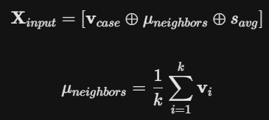

3. LJP Module: Feature Construction
Algorithm: Neighbor-Aware Feature Concatenation. Explanation: Instead of predicting based on the case text alone, we construct a composite feature vector that includes the "legal neighborhood..
Formula for Slide:
Where:
denotes vector concatenation
is the embedding of the current case.
is the centroid (mean) of the top-k retrieved neighbors.
is the average similarity score of those neighbors.

Slide 14
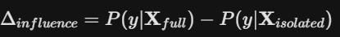
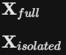
4. LJP Module: Neighbor Influence (XAI)
Algorithm: Feed-Forward Multi-Layer Perceptron (MLP). Explanation: The constructed features are passed through a non-linear neural network to classify the judgment as Plaintiff, Defendant, or Dismissal.
Formula for Slide:
Where:
includes the neighbor context.
replaces neighbor features with zeros

Slide 15
Work (Improvement on the Paper)
Key Learnings & Improvements:
Data Hygiene: Discovered that ~15% of raw legal data is "procedural noise" (1-line orders). We implemented a custom filter (min_length=800) to clean this.
Explainability: The original paper was a "black box." We added the Neighbor Influence Delta to quantify exactly how much precedents affect the outcome.
System: Upgraded from a static script to a Full-Stack Web App (React + Flask).
Real-World Applications
Legal Triage for Pro-Bono Clinics:
Application: Legal aid clinics are often overwhelmed. AdvocaDabra can serve as a "first-pass" filter to identify cases with high merit (Plaintiff probability > 70%) versus those likely to be dismissed.
Evidence: Your ljp.py outputs a specific probability score (e.g., "99.6% Defendant"), allowing clinics to prioritize resources effectively.

Slide 16
Limitation:
The model currently struggles with complex "Plaintiff" arguments (62% precision), leaving room for future work with larger Language Models (LLMs).
Potential Improvements (Future Work):
Dynamic Knowledge Updates:
Point: The FAISS index is currently static. An improvement would be a "Live Ingestion Pipeline" that scrapes court websites daily and incrementally updates the vector database without retraining the whole model.
Handling Long Documents:
Point: The e5-base model typically has a token limit (512 tokens). Implementing "chunking strategies" with weighted averaging would prevent the loss of information in very long legal briefs

Slide 17
Performance Analysis (Our Metrics):
SCR Module: Evaluated on ~5,000 cases. Mean Similarity: 0.829.
PCR Module: Re-ranking algorithm increased similarity to 0.876.
Court Authority: Average score of 2.24, proving the system favors higher courts
(Circuit/Appellate) over Trial courts.
Comparison with Paper:
While the original paper focused on theoretical accuracy, we added real-time explainability (Influence Delta).
We found explicit reasoning markers in only 8.6% of precedents, highlighting the need for our deep
learning approach over simple keyword search.
Challenges & Solutions: Challenge: Data "Noise" (Procedural junk). Solution: Implemented filters for "Motion Denied" and cases <800 chars. Challenge: Class Imbalance (More Defendant wins). Solution: Used weighted metrics to ensure Plaintiff cases weren't ignored.

